Slide 1
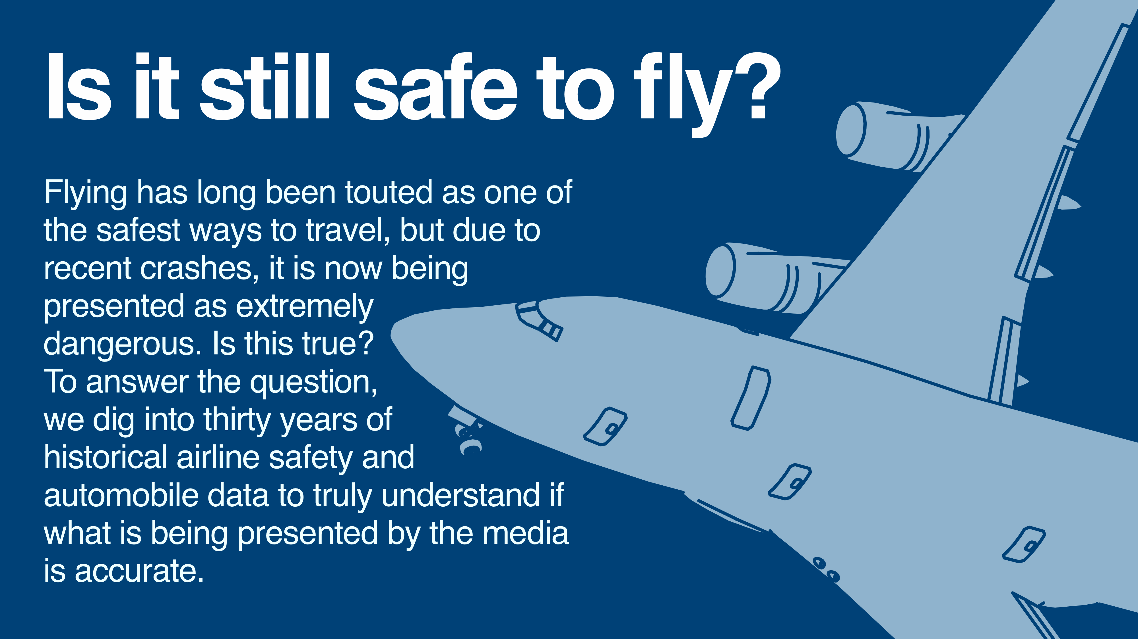

Notes:
Recent airline events have caused a lot of discussion and media reporting that flying is no longer safe, that it is dangerous, and that there is a lot of risk involved with getting on an airplane. Is this true? To verify if these claims are accurate, I looked at thirty years of data from the Aviation Safety Network, the National Highway Traffic Safety Administration, and the National Safety Council.
As I began looking into the historical accident and fatalities numbers across both airline and automobile industries, a different story than the one being reported started to unfold.

Slide 2
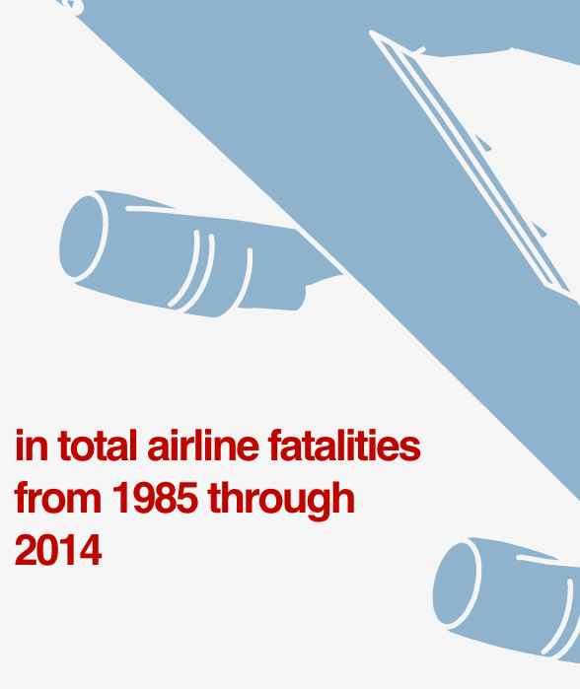
Notes:
Covering a 30-year span from 1985 through 2014, we have three sets of airline-related data to look at here.
The first one shows that the total number of airline fatalities over this thirty years has decreased by 51%. That’s a pretty remarkable number. In correlation with the fatalities number, the total number of airline incidents also decreased by 43%. Looking at the total number of fatal accidents in the airline industry there was a huge decrease from 122 down to 37, a decrease of 70%. What do these numbers mean? The data is telling us that it is actually getting safer to fly.

Slide 3
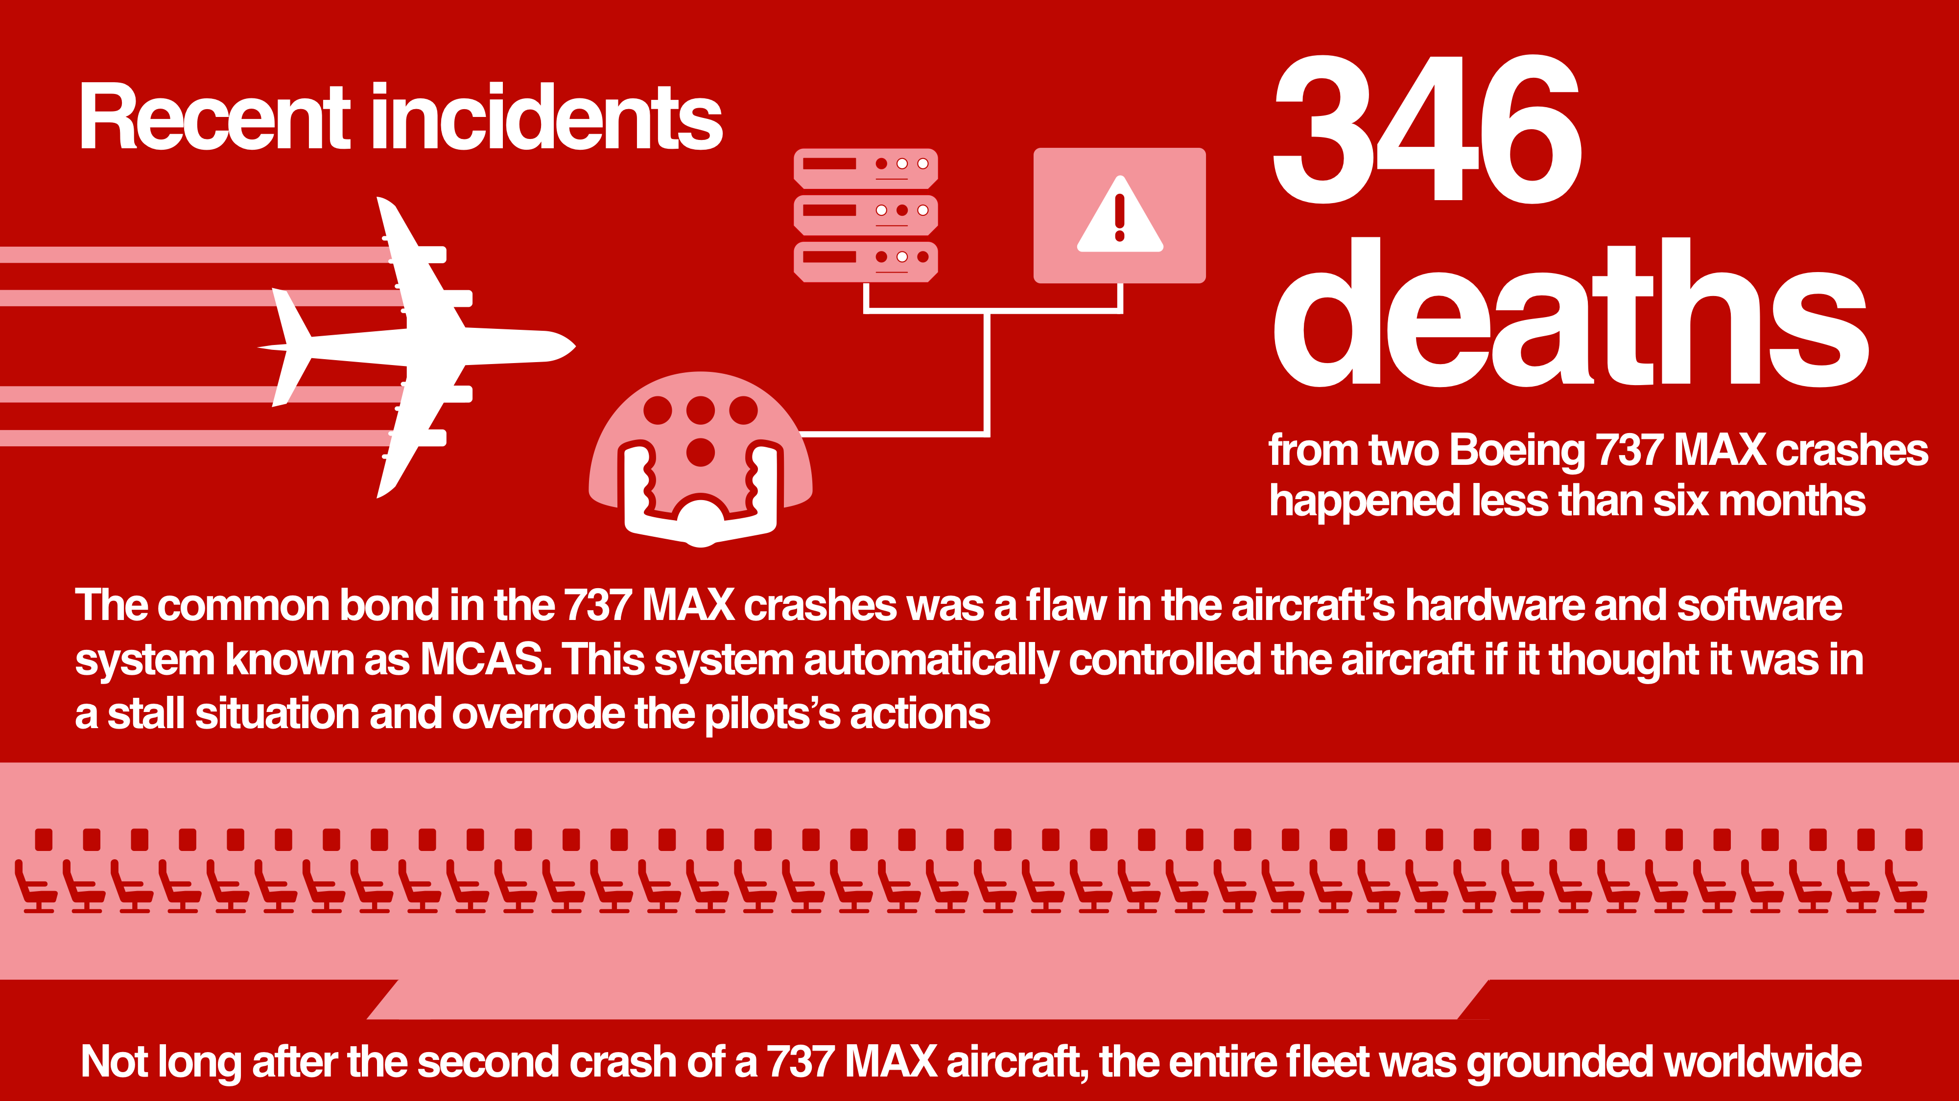
Notes:
If the statistics are showing that it is getting safer to fly, why is there all of this recent panic? One faulty component on a new aircraft is why.
Let’s get into the recent events that are the primary source of this fear of flying — the deaths related to Boeing’s 737 MAX aircraft. The 346 fatalities from this particular aircraft came from two different flights less than six months apart, each from different airlines. Their common bond is the flaw in the aircraft’s hardware and software system (MCAS) — which stands for maneuvering characteristics augmentation system — that automatically control the pitch of the aircraft if it detects a stall position (for example one where the plane is climbing at a higher angle, usually in takeoff situations). The MCAS hardware and software combination was faulty, causing the 737 MAX planes to override pilot control, automatically and continuously driving the nose of the plane down, causing them to crash. Not long after the second incident of a Boeing 737 MAX aircraft, the entire fleet was grounded. The crashes of these particular aircrafts from Boeing are the primary reason for the cause of panic regarding flying and these crashes are extremely atypical of the industry at large.

Slide 4
Notes:
From 2000 through 2014, there were an unfortunate total of nearly 580,000 fatalities from automobile and airline crashes. This is a devastating number, and it is painful to have these number be anything other than zero. Digging into the data behind these fatalities numbers, something rather interesting jumps out.

Slide 5
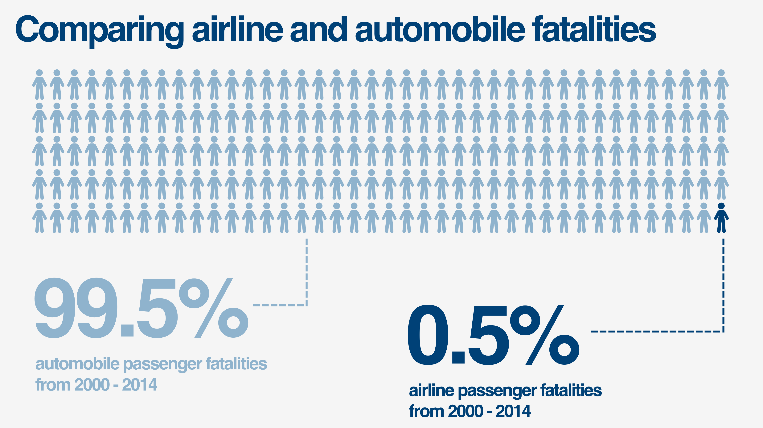
Notes:
Of those total fatalities…3,109 were airline-related. That comes out to half of one percent. While the perception might be that flying isn’t safe, the data shows that flying is much safer than driving.

Slide 6
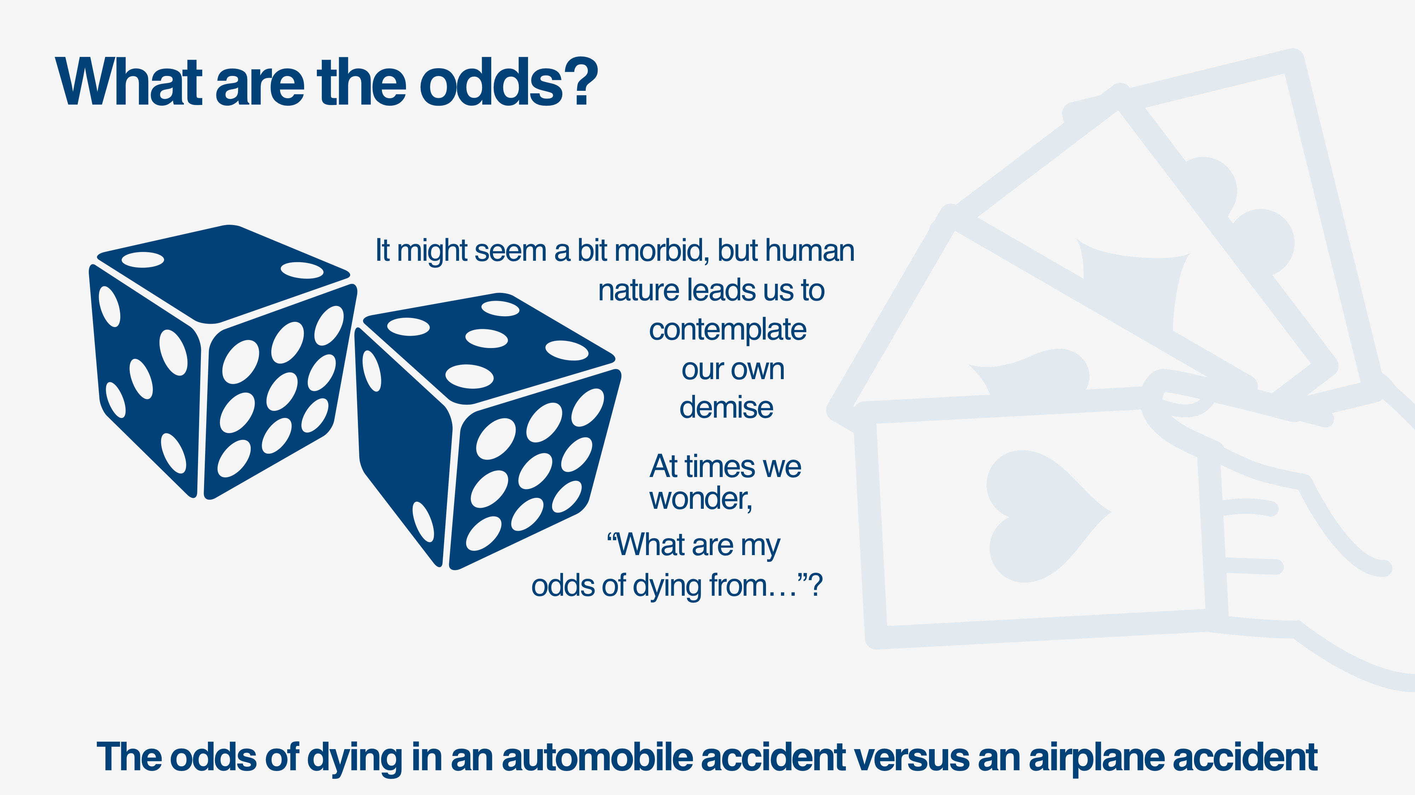
Notes:
The last set of data to talk about regarding airline safety is a bit morbid, but as human beings we are prone to contemplate our own demise. That is why we tend to make decisions attempt to maximize our life expectancy. Let’s explore the odds of dying in an automobile accident versus an airplane accident.

Slide 7
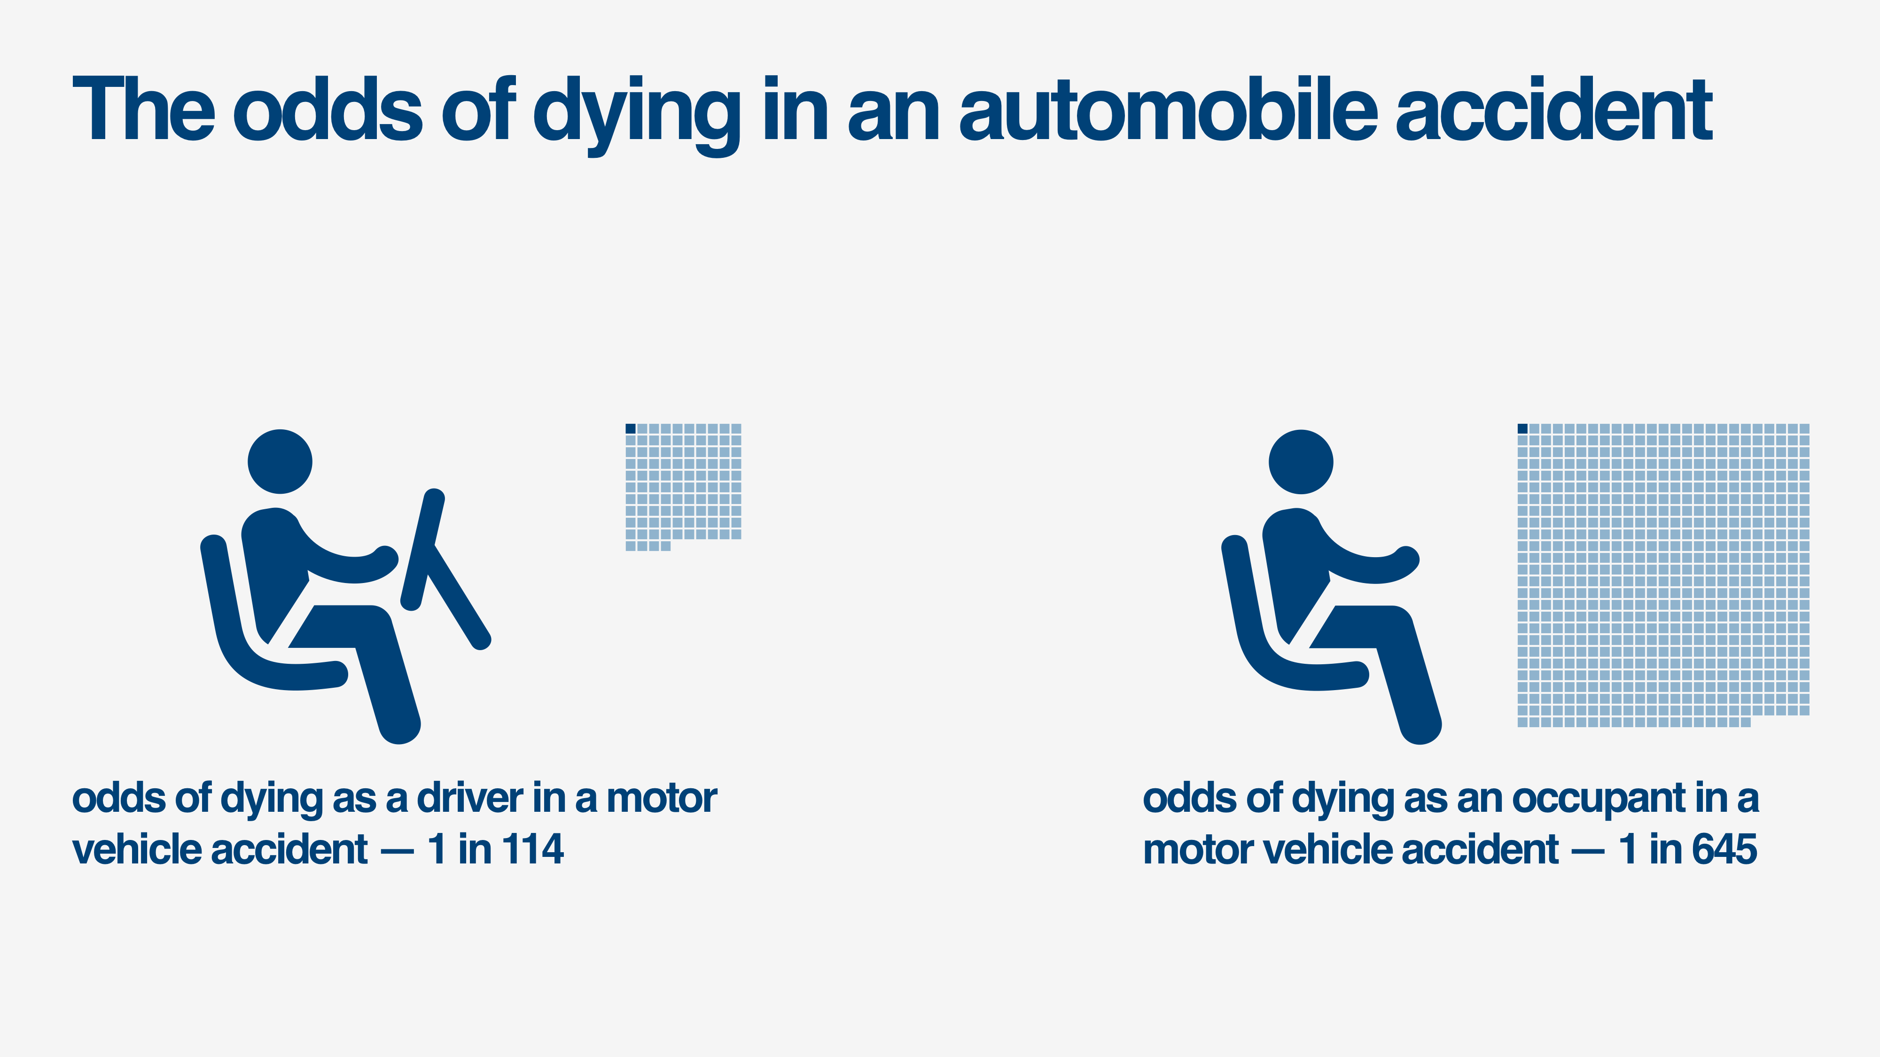
Notes:
Any guesses as to what these numbers will be? Let’s dive into the data.
According to the numbers, as you can see, the odds of dying as a driver in an automobile accident are 1 in 114. This data mostly reflects single-occupant vehicular accidents. The graphic on the right is for automobile passenger data, and it shows that the odds of dying as a passenger in an automobile accident are 1 in 645.

Slide 8
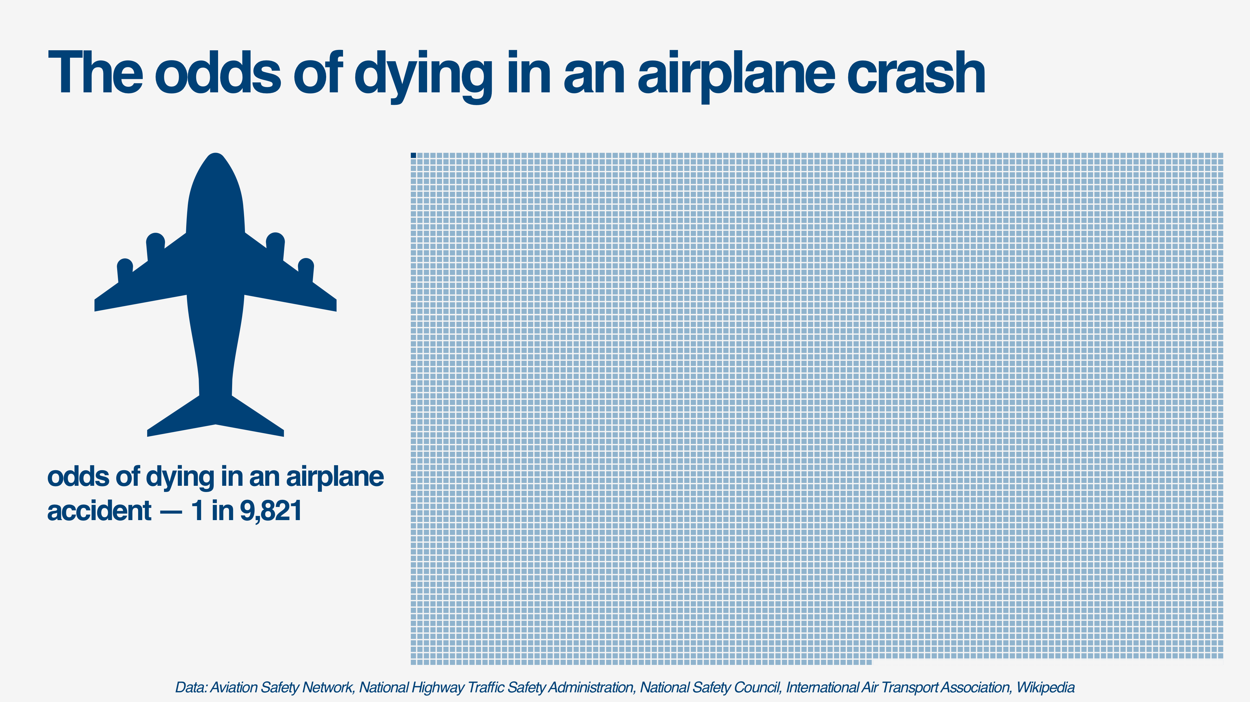
Notes:
That brings us to the odds of dying in an airplane accident. This graphic needed its own screen. As you can see here, the odds of dying in an airplane accident are 1 in 9,821.
To wrap things up… while the recent events of Boeing’s 737 MAX airplanes have caused a lot of panic about the safety of flying, the data shows that airline incidents and fatalities have actually been on the decline and statistically you are much safer in an airplane than an automobile.

